Slide 1

Mental Poker and The Oblivious Transfer

Slide 2
Mental Poker and Oblivious Transfer
Mental poker is played like ordinary poker but without cards and verbal communication; all exchanges between the players must be accomplished using exchanged messages. Any player may try to cheat. The requirements for a fair game are listed as follows:

Slide 3
Mental Poker (Security requirements)
The game must be a “fair deal”. Assuming the players have exchanged a sequence of messages to accomplish this. Then,
a. the players should know the cards in
their own hand; but not the others;
b. all hands must be disjoints; and
c. all possible hands must be equally
likely for each player.

Slide 4
Mental Poker (Security Requirements)
During the game, players may want to draw additional cards from the remaining deck. These must also be dealt fairly as described in previous slide. Players must be able to reveal cards to their opponents without compromising the security of their remaining cards.
At the end of the game, the players must be able to check that the game was played fairly, and that their opponents did not cheat.

Slide 5
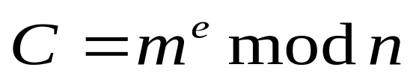
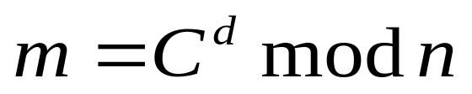
Pohlig-Hellman Scheme (One-Key System)
Before we lecture into the Mental Poker, we should introduce the Pohling-Hellman Scheme.
Let’s say A is sending a message (m) to B.
A m B Public parameter:
n=( p * q), where
p and q are large primes.
Private key : e d
e * d mod φ(n)=1 En:
A and B share the knowledge De:
of e and d.
* We can also replace n by p; therefore, e * d mod p-1 =1.

Slide 6


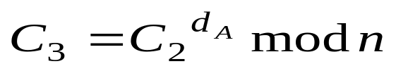
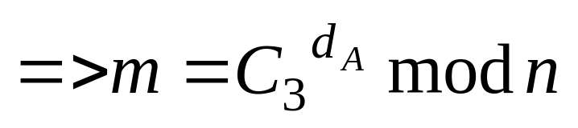
No-Key System
Let’s say A is sending the message (m) to receiver B.
A B
Public parameter: n(=p*q) or p
Private key: eA, dA eB , dB

Slide 7
Mental Poker
Assume that there are two players, Bob and Alice, who are playing the poker game on the Internet. Bob has his secret keys (EB, DB) and Alice has her secret keys (EA, DA). The keys are not revealed until the end of the game.
There are 52 cards in a deck and these cards are represented as
{M1,M2,…………M52}
Each player will have 5 cards initially.

Slide 8
Mental Poker
Bob is the dealer.
The protocol for a fair deal is follows:
1.Bob encrypts these 52 cards, shuffles (permutes) the whole deck and then sends them to Alice.
EB(M_{i}), for i= 1,2,……..,52.
2. Alice randomly selects 5 encrypted cards, { C1 , C2, C3, C4, C5}, and returns them bake to Bob. Bob deciphers these five cards by DB and determines his hand, where DB EB (mi )=mi .

Slide 9
Mental Poker
3. Alice selects five cards,{C1 ′, C2′ C3′, C4′, C5′} for herself. Alice uses her own encryption key, EA, to encrypt her five cards and sends the cards to Bob.
Ci ′ ′ =EA(Ci ′), i=1,2,3,4,5.
4. When Bob receives Alice’s fives cards, he uses his decryption key to decipher the five cards, where DB(EA(EB(mi))=EA(mi). After Bob deciphering the cards, he sends the cards, which are encrypted by Alice’s key (EA), back to Alice.

Slide 10
Mental Poker
5. When Alice gets her own cards back, she uses her decryption key (DA) to decipher the cards, where DA(EA(mi))=mi.
6. At the end of the game, both players reveal their secret keys to prove that they did not cheat.

Slide 11
Mental Porker
B A
permuted EB(Mi), i=1,2,…,52
C1 ,C2 ,C3 ,C4,C5 randomly selects
EA(Ci ′), i=1,2,…,5
DB(EA(Ci ′)), i=1,2,…,5

Slide 12
Mental Poker
This game may seem fair to both players; but the truth is that this game is not truly fair because Alice can have the advantage to win this game by exploring the property of “Quadratic Residue”.

Slide 13
Quadratic Residue
A number a is a quadratic residue modulo n if gcd(a, n)=1 and there exists an x such that
x² mod n = a , x is called “Quadratic Root”.
R2 denotes the set of quadratic residues modulo n.
Example:
1² mod 7=1
2² mod 7=4 1,2,4 ∈R2
3² mod 7=2 3,5,6 ∉ R2
4² mod 7=2
5² mod 7=4
6² mod 7=1

Slide 14
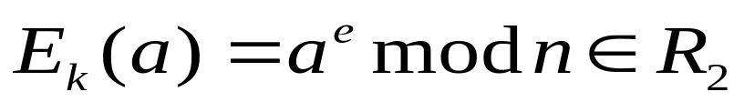
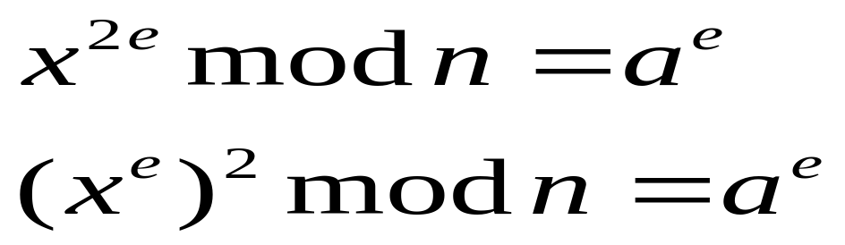
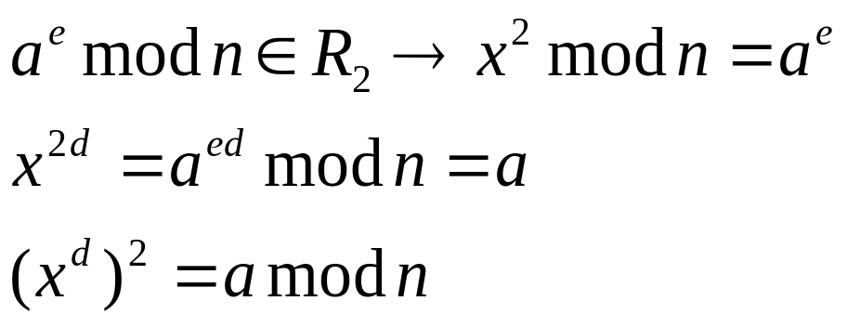
Quadratic Residue
(Theorem)
For 0 < a < n, a ∈R2 , if and only if
Proof: Given a∈R₂ → x² mod n = a
Similarly, given

Slide 15
Quadratic Residue
(Back to Mental Poker)
Alice can split a deck of cards into two sets, namely “quadratic residue” and “quadratic nonresidue”. For example, the “K, Q, J, A and 10” are in the set of “quadratic residue”. When Alice selects the five cards for Bob, she can select the cards from the set of “quadratic nonresidue” and gives these five cards to Bob. Also, when Alice selects five cards for herself, she can select the five cards from the set of “quadratic residue”. Therefore, Alice will have bigger chance to win the game over Bob.

Slide 16
Quadratic Residue
(Theorem)
Given X² mod p = a, then
there are either 2 solutions or no solution.
Proof:
If X1 is one of the solutions
=> X1² mod p = a
( p – X1)² mod p= (p² - 2pX1+ X1²) mod p = a.
Example:
p=7
1² mod 7=1
2² mod 7=4
3² mod 7=2
4² mod 7=2
5² mod 7=4
6² mod 7=1

Slide 17
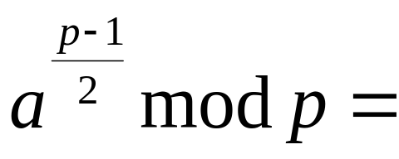
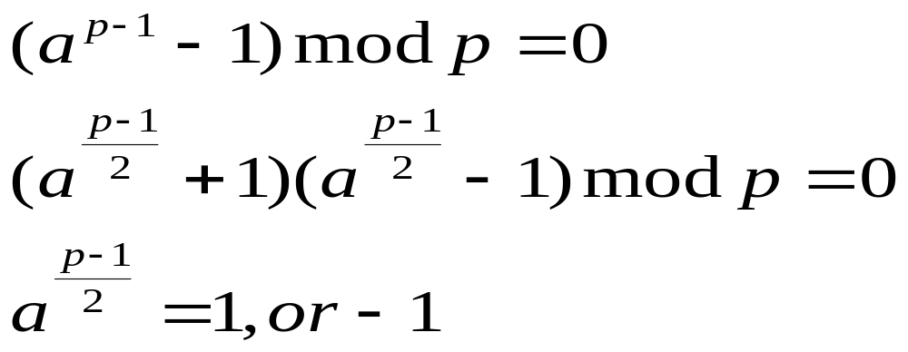
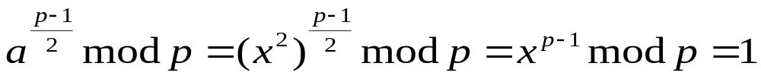
Theorem 2.5
For prime p > 2 and 0 < a < p,
then 1 if a∈R2
-1 ( or p-1) otherwise
Proof:
If a∈R2 => X² mod p = a

Slide 18
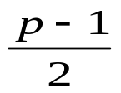
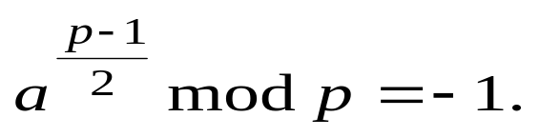
Theorem 2.5
(continue)
Since there are quadratic residues satisfying above equation, the
remaining elements satisfying

Slide 19
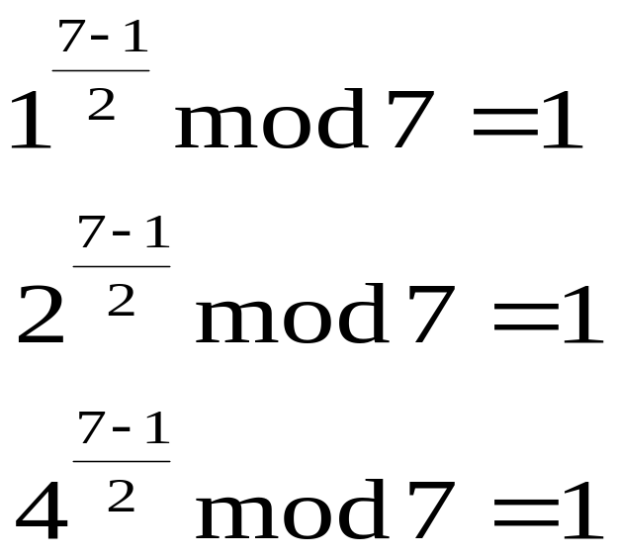
Theorem 2.5
Example:
p=7
1² mod 7=1
2² mod 7=4
3² mod 7=2
4² mod 7=2
5² mod 7=4
6² mod 7=1
So, {1,2,4}∈R2.

Slide 20
Oblivious Transfer
Alice can transfer a secret to Bob with probability ½. Thus, Bob has a 50% chance of receiving the secret and a 50% chance of receiving nothing. On the other hand, Bob will know whether he has received the secret; Alice will not. Clearly, the uncertainty must be agreeable to both Alice and Bob, or one of them would refuse to cooperate.

Slide 21
Oblivious Transfer
Protocol
1. Alice sends to Bob the product n of two distinct odd primes p and q. The primes p and q represent her secret.
2. Bob picks a number x at random, where 0<x<n and gcd(x, n)=1, and sends a to Alice,where a=x² mod n.
3. Alice, knowing p and q, computes the four roots of a: x, n-x, y, n-y. She picks one of these roots at random and sends it to Bob.

Slide 22
Oblivious Transfer
(continue)
=>
4.If Bob receives y or n-y, he can determine p and q from x and y/n-y by computing
gcd(x+y, n)=p or q .

Slide 23
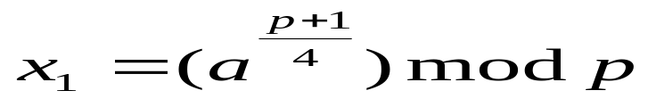
Oblivious Transfer (How it works)
x² mod n (=p*q) =a
solve x² mod p=a x1 x1 p-x1 p-x1
x² mod q=a x2 q-x2 x2 q-x2
Then x mod p= x1 x1 p-x1 p-x1 Chinese Remainder
x mod q= x2 q-x2 x2 q-x2 Theorem to find x
Solve:
If p+1 is divisible by 4
then is one solution.

Slide 24
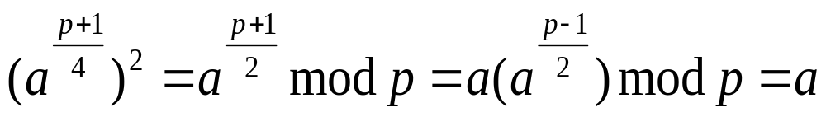
Oblivious Transfer (How it works)
Proof:
∴ it is a solution.
=> the other solution is p-x₁.

Slide 25
Oblivious Transfer (How it works)
Example:
p = 3 and q = 7
x² mod 21 = 4
=> x² mod 3 = 1 => x₁=1,2
x² mod 7 = 4 => x₂= 2, 5
x mod 3= 1 1 2 2 => Chinese Remainder
x mod 7= 2 5 2 5 Theorem
x= 16, 19, 2, 5
Note: 16, 5 are additive inverses.
19, 2 are additive inverses.

Slide 26
Oblivious Transfer (How it works)
Suppose that Bobs knows x and y.
then Bob knows that
x mod p = x1 and y mod p = x1
x mod q = x2 y mod q = q – x2
Thus,
x + y = mq.
so, gcd (x+y, n)=q.
In previous example, if, Bob know 16 and 19,
then gcd (16+19, 21)=7=q.

Slide 27
Coin Flipping Protocol
Alice selects two large primes p and q and sends n=pq to Bob.
Bob checks if n is prime, a prime power, or even; if so, Alice cheated and loses. Bob picks an x and sends a=x² mod n to Alice.
Alice computes the four roots of a, picks one at random, and sends it to Bob.
Bob wins if he can factor n.

